Slide 1
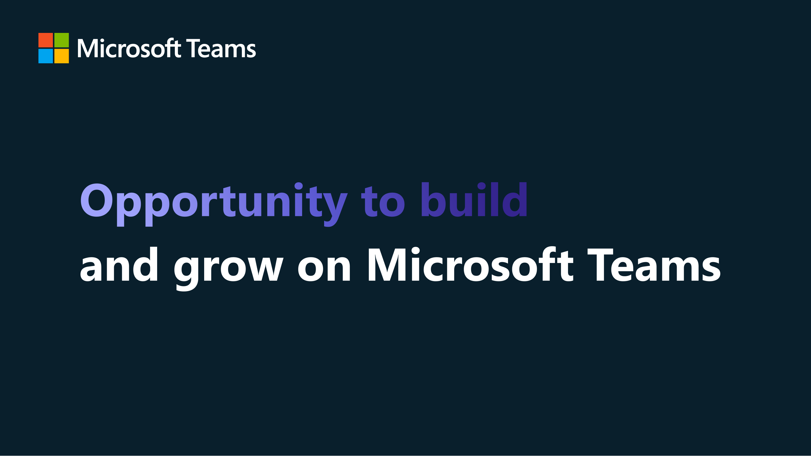


#TeamsAppCamp

Slide 2
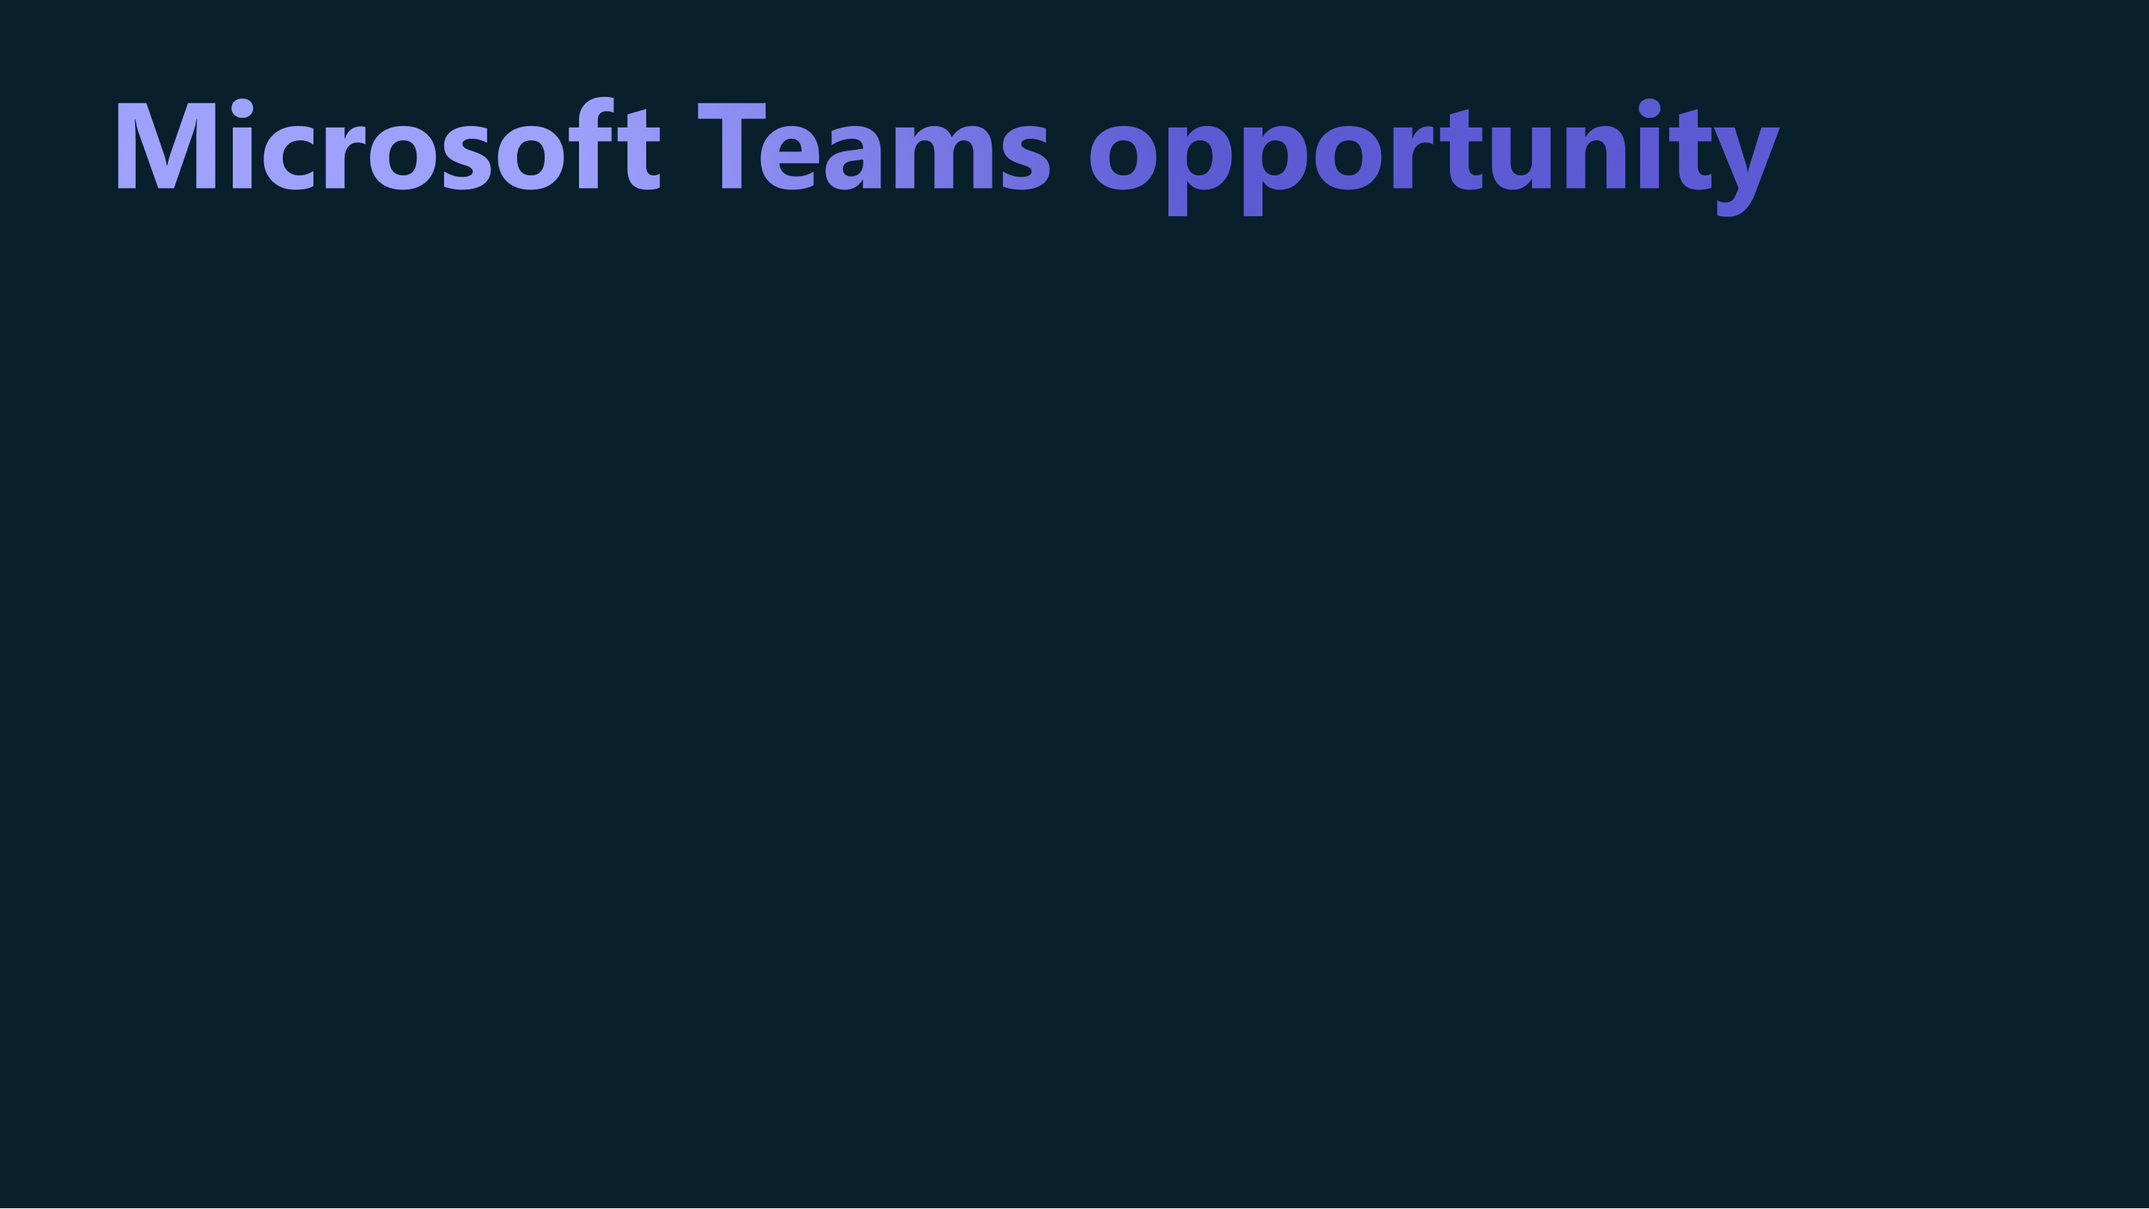

Microsoft Teams is a collaboration tool and application distribution platform that helps partners deliver their solutions where millions of users connect and get their work done in today’s hybrid workplace.
Put your application at the Center of Hybrid Collaboration
#TeamsAppCamp
Notes:
There’s a great opportunity for customers and partners to build on the Microsoft Teams platform. Microsoft Teams is a platform where millions of users connect in today’s hybrid workplace.
Customers can manage distribution of their apps, targeting specific users and roles
Partners can sell their applications in the Microsoft Teams App Store and App Source and Microsoft will handle the customer transactions.

Slide 3
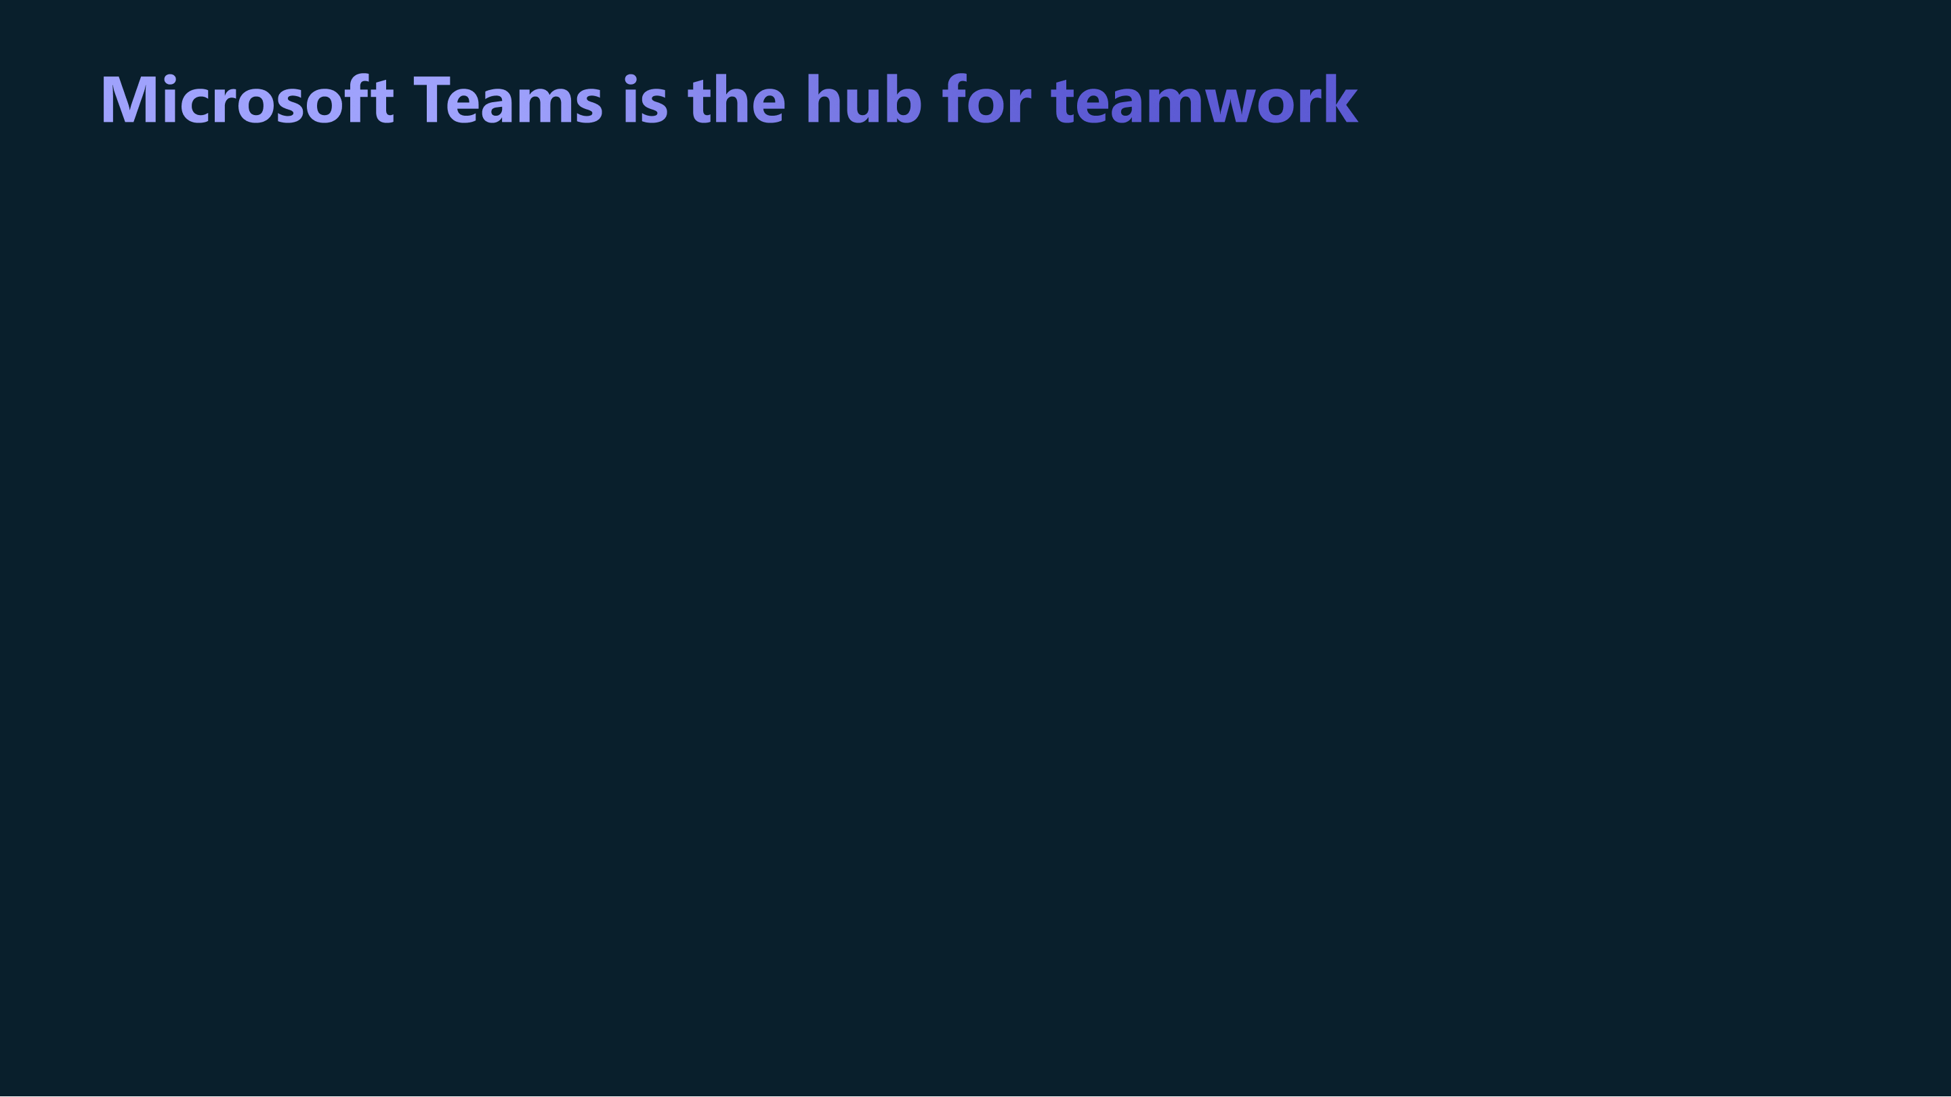

Chat
Meetings
Collaboration with the power of apps
Business process workflows
#TeamsAppCamp
Notes:
Microsoft Teams is more than a collaboration tool. It’s a hub for teamwork that supports all the ways people work today.
A lot of work is collaborative – it doesn’t happen in a vacuum. Today’s worker needs to be great at synchronous, asynchronous as well as remote collaboration. And Teams works in all these modes, as people meet, chat, call, and collaborate. It’s even more powerful if they can use the applications they need in the same ways.
Microsoft Teams is an organizing layer – organized by the patterns in which people work together. Teams applications can work within work groups and communities to offer a uniquely connected experience. By building an application directly into Teams, developers can create new and improved process workflows, shared experiences in meetings, and the ability for users to pass work around in a streamlined manner.
These collaborative apps are a big paradigm shift; instead of being islands of information, these apps bring business workflows, data and insights to people as they work together. Users can stay in their flow of work and share context with their teammates.
Teams customers can find 3rd party applications in the Teams app store, allowing them to bring them into the context of where they are working.

Slide 4

The fastest-growing business application in Microsoft history
270M
60M
500,000+
x10
1600
181
More than 270 million monthly active users of Microsoft Teams
Nearly 60M daily active users of Teams mobile, more than doubled since March 2020
More than 500,000 organizations use Teams
Monthly usage of third-party and custom-built apps in Teams has grown more than 10x over the last two years
The number of apps built by Microsoft partners and available in the Teams app store
Teams in 181 markets with support for 53 languages and growing
© COPYRIGHT MICROSOFT CORPORATION. ALL RIGHTS RESERVED.
Notes:
With 270 million monthly active users, Microsoft Teams has become the new way where people are connecting and collaborating.
Since the start of 2020, monthly usage of third-party apps and custom-built solutions within Teams has grown nearly 10 times. In the past year, the number of applications created by developers, partners, and customers for Teams has grown dramatically- with1600 partner apps in the Teams app store and 80,000 lines of business apps that have been custom built for Teams in use by our customers.
Our customers are using Teams and are using applications built on Teams all over the world.

Slide 5
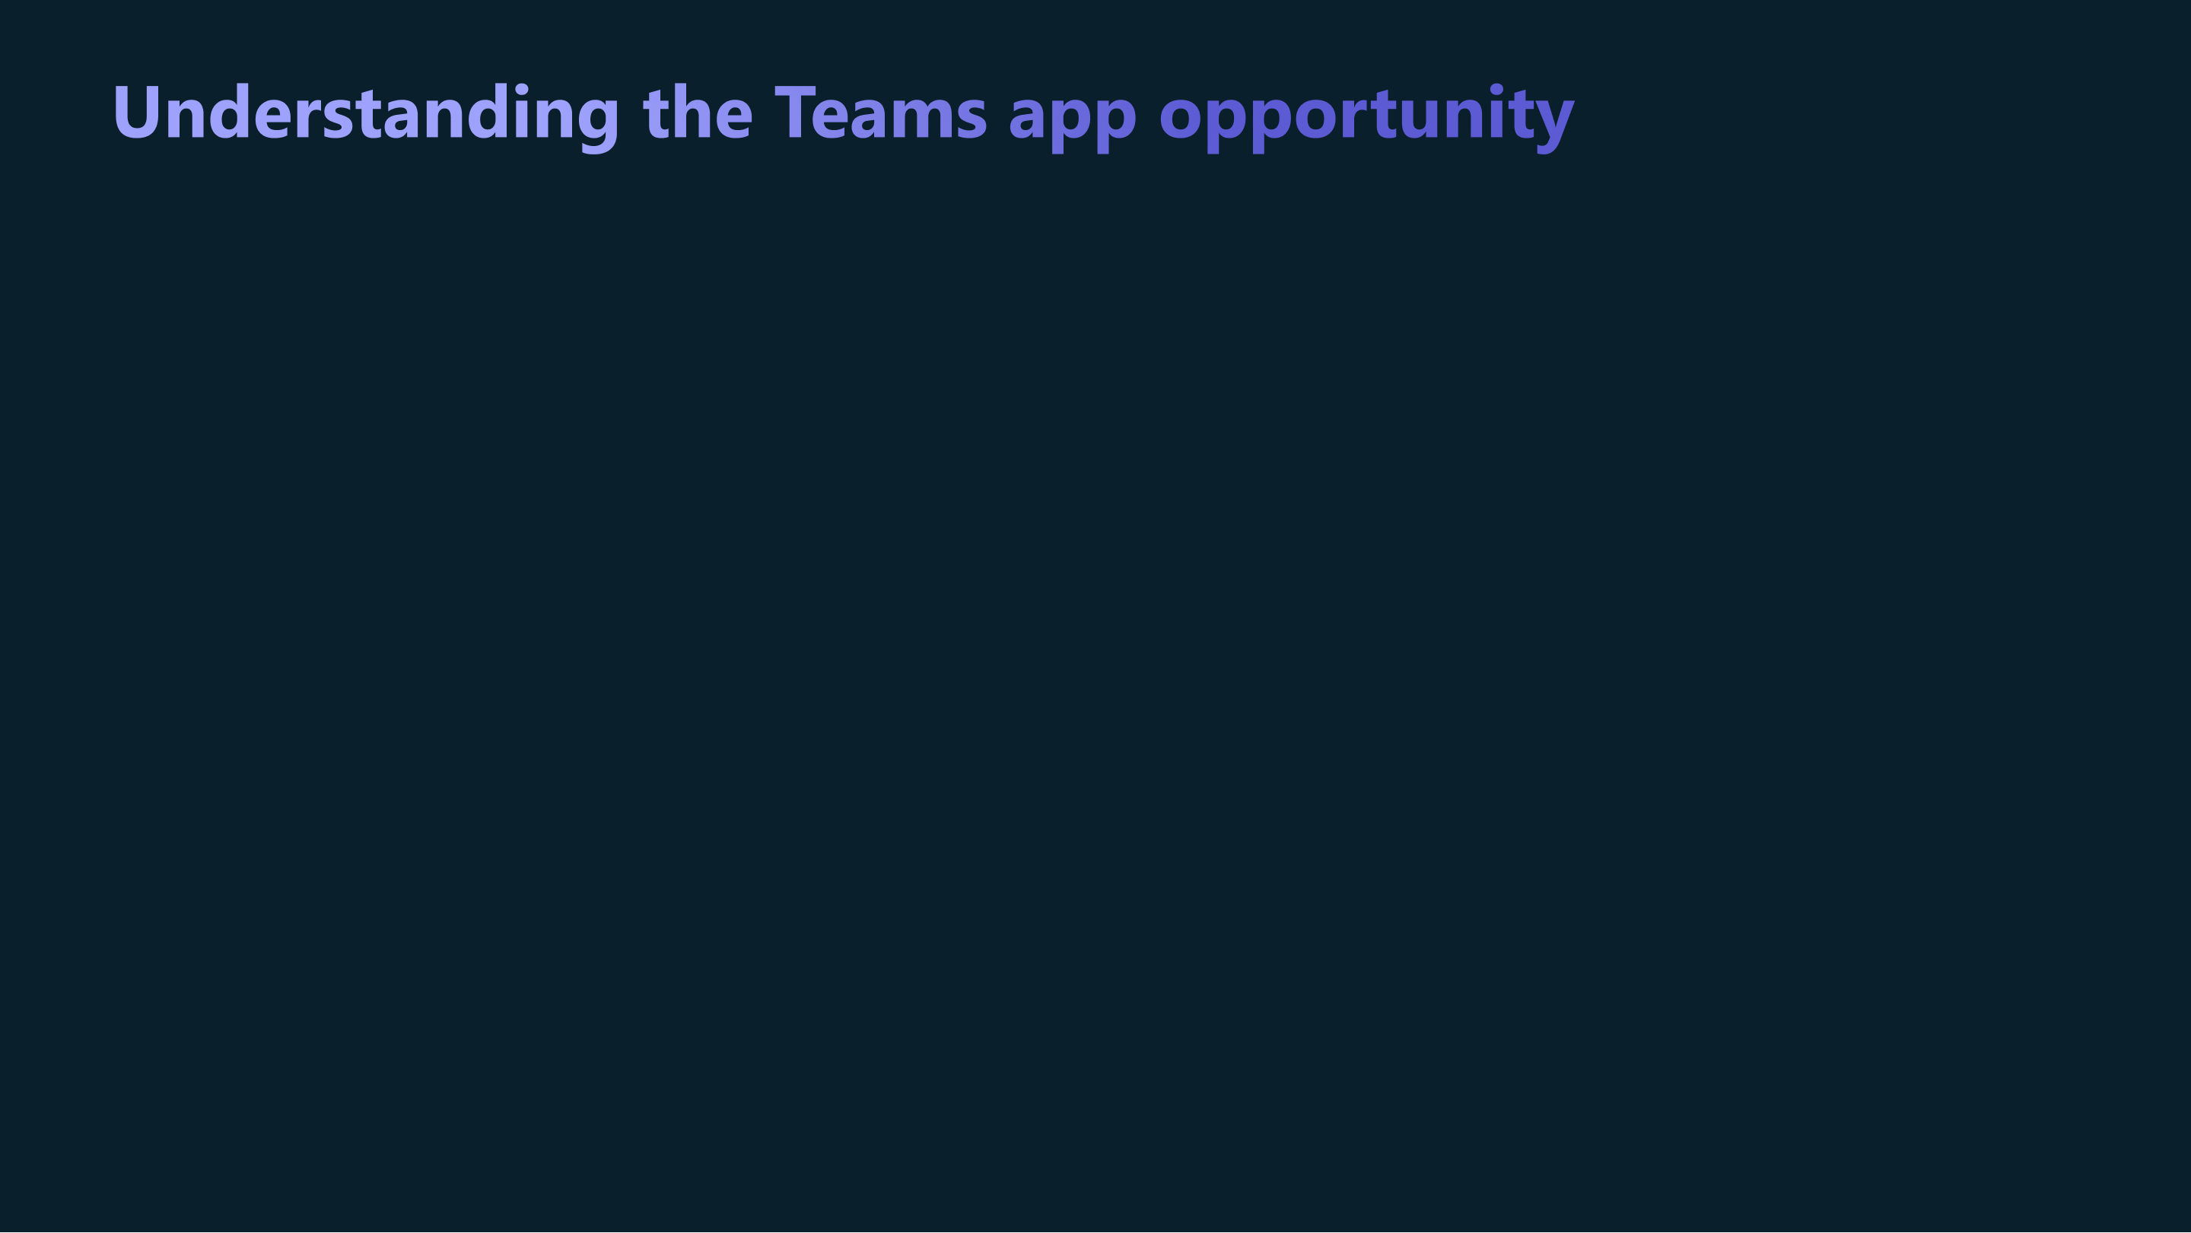
Reach a broader audience
Leverage product innovation
Increase sales and reduce costs
Notes:
For partners, there are three main potential advantages about building an integration into Teams.
1. Ability to Reach a broader audience—Build connections to Microsoft 365 and the robust community of Teams daily users
2. Ability Leverage product innovation—Improve your application’s experience for your customer and create new workflows by engaging your users through the Microsoft 365 suite of communication and collaboration capabilities
3. Ability Increase sales and reduce development costs—Develop once and deploy your application on any Teams surface area client—web, desktop, and mobile

Slide 6
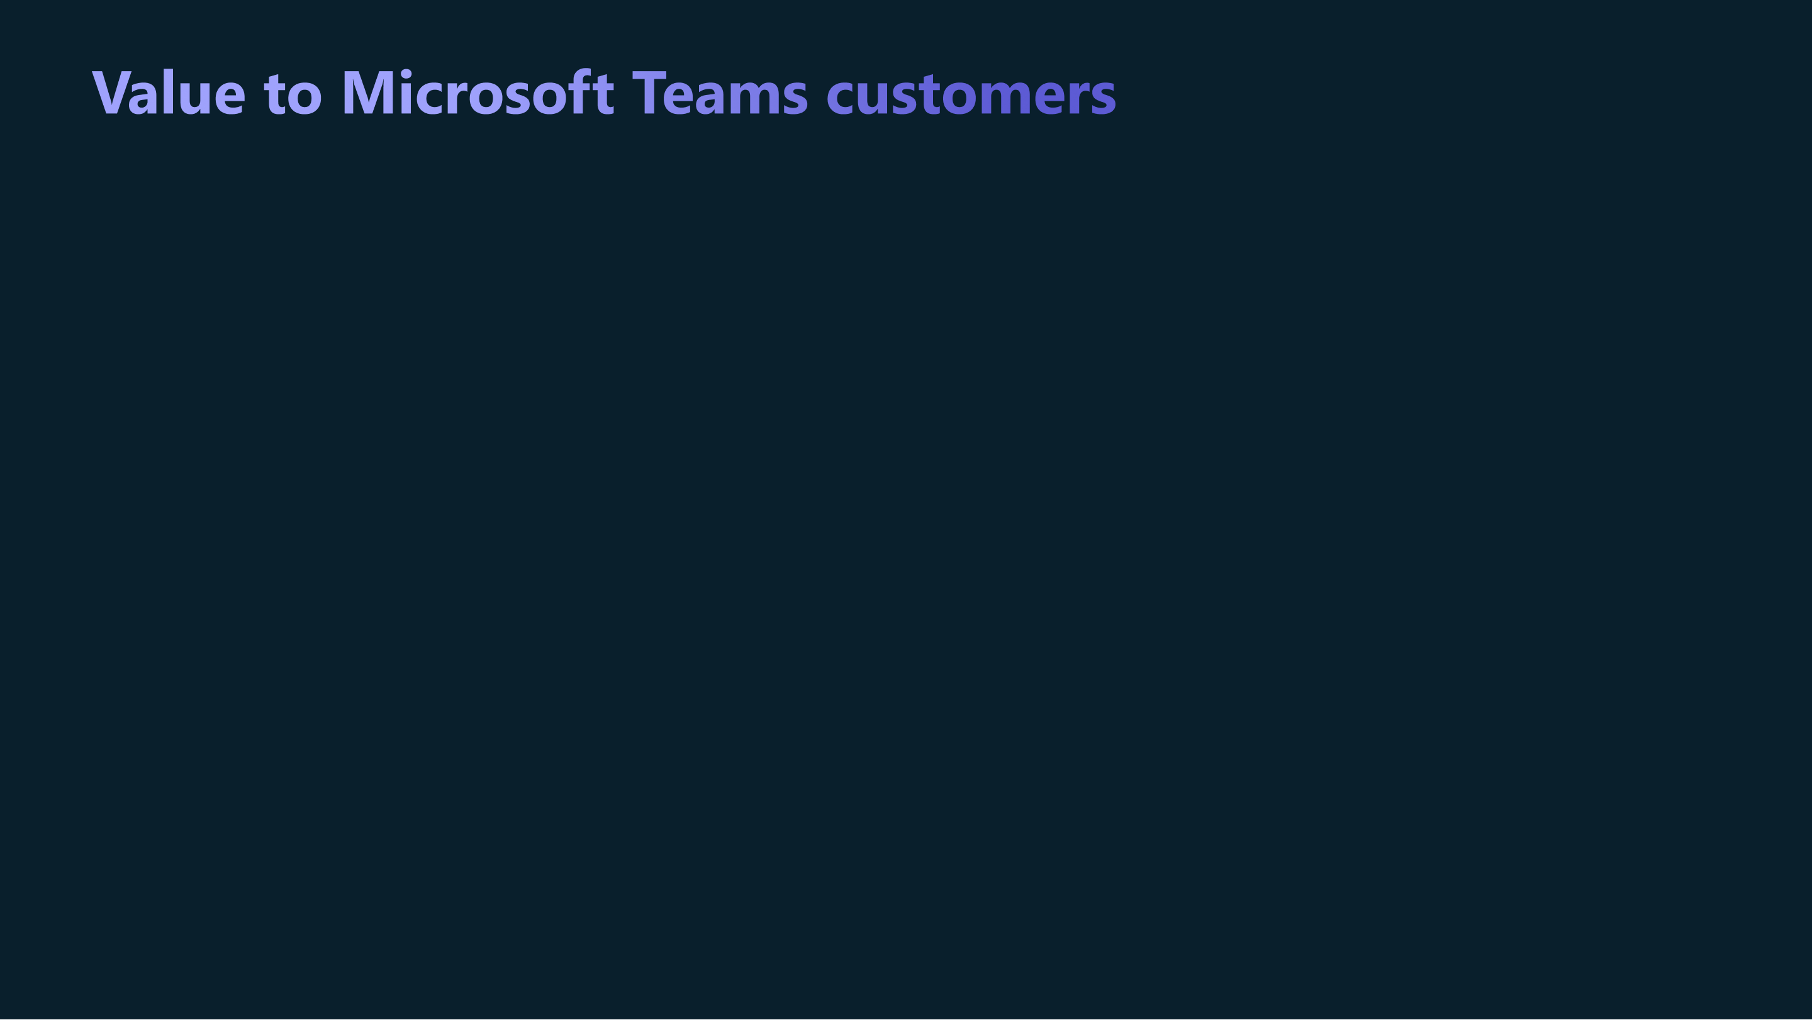


I think the advantage with the integration into Teams is just being able to have an app within the context of the work the group is doing. That’s the beauty of Teams, it brings stuff into context and cuts out time it takes to find information.” ¹
¹ Office 365 product manager, Telecom company
¹ A commissioned Total Economic Impact™ study conducted by Forrester Consulting on behalf of Microsoft: Business Benefits and Cost Savings Enabled by Partner Applications for Microsoft Teams, March 2020
Notes:
In today’s evolving global economy, customer leaders are looking not only to create impact faster but to prioritize investments that will drive the most important and meaningful business outcomes for their organizations. Our customers have told us they value the time savings that their employees can gain through rich integrations into Teams. It cuts out the time it would otherwise takes to search around multiple systems to find relevant information and transfer that information back and forth to share with colleagues. A quality integration can be turned on directly into the flow of where people work, boosting productivity. Gives people info when and where they need it. This helps companies maximize their investments with technology that it is already using to be able to achieve more. In other words, achieving more with less.
https://devblogs.microsoft.com/microsoft365dev/ignite-2022-transforming-collaboration-with-low-and-pro-code-dev-tools/

Slide 7




7
The Teams product group and Microsoft for Startups team were helpful from the outset. They helped us get Productboard right within their ecosystem and build our go-to-market strategy. That’s been critical for our business”
— Hubert Palan
CEO, Productboard
When you add up all the pieces, working with Microsoft is a great opportunity for a startup not just because of the product benefits but also the commercial dimensions and distribution that you get from the relationship”
— Dan Reich
CEO, Troops
Any startup that wants to work with enterprise customers would be negligent to not make working with Teams a priority”
— Scott Burns
CEO, Structural
Notes:
What about value to partners? Many partners have seen immediate value working within the Microsoft ecosystem.
Here is what some startup partners who were new to the Microsoft ecosystem have said about working with Microsoft and how their being in the MS Teams ecosystem has made an impact to their business.
Articles: Productboard harnesses Microsoft Teams to streamline customer-centric product management
Troops drives powerful, actionable CRM data and workflows into Microsoft Teams
Structural brings innovative workplace discovery features to Microsoft Teams, doubles growth

Slide 8

By the numbers
40%-250%
Up to 400%
84%
Increase of deals the first year, as compared to a baseline of non-Teams apps ²
Increase in Teams-related deals as compared to baseline ²
Surveyed partners who agree that Teams apps open new revenue streams for their SaaS business ¹
¹ A commissioned Total Economic Impact™ study conducted by Forrester Consulting on behalf of Microsoft: Business Benefits and Cost Savings Enabled by Partner Applications for Microsoft Teams, March 2020
² A commissioned Total Economic Impact™ study conducted by Forrester Consulting on behalf of Microsoft: The Partner Opportunity for Creating Microsoft Teams Applications. A Total Economic Impact Partner Opportunity Analysis, May 2021
Notes:
Here are some statistics about how Teams have driven meaningful growth for our partners. Partners have reported that they have seen increased number of deals, increased deal sizes, and new revenue streams when they build and integrate their solutions into Microsoft Teams. Now that we’ve looked at numbers lets look at specific examples.

Slide 9
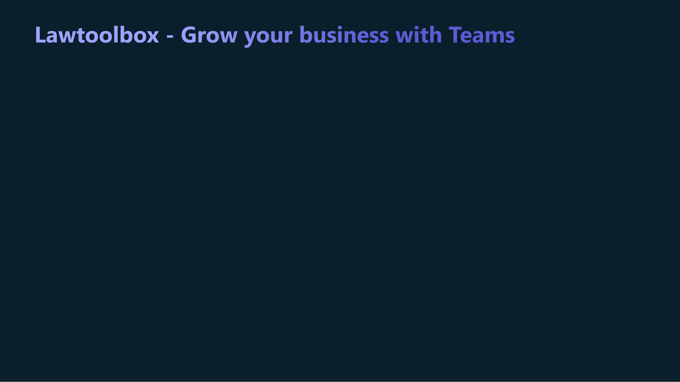
Situation: Lawtoolbox enabled law firms and general counsels to collaborate with their clients and outside counsel in a secure and modern platform that keeps their data secure in their Microsoft 365 tenant.
Result: Partner leveraged Microsoft Commercial Marketplace to reach new customers and grew its revenue 2X in 2 months and 105% increase in licenses transacted
Lawtoolbox + M365
Notes:
Case study: https://partner.microsoft.com/en-us/case-studies/lawtoolbox
Video: https://cloudpartners.transform.microsoft.com/practices/modernworkisv?tab=success-stories

Slide 10
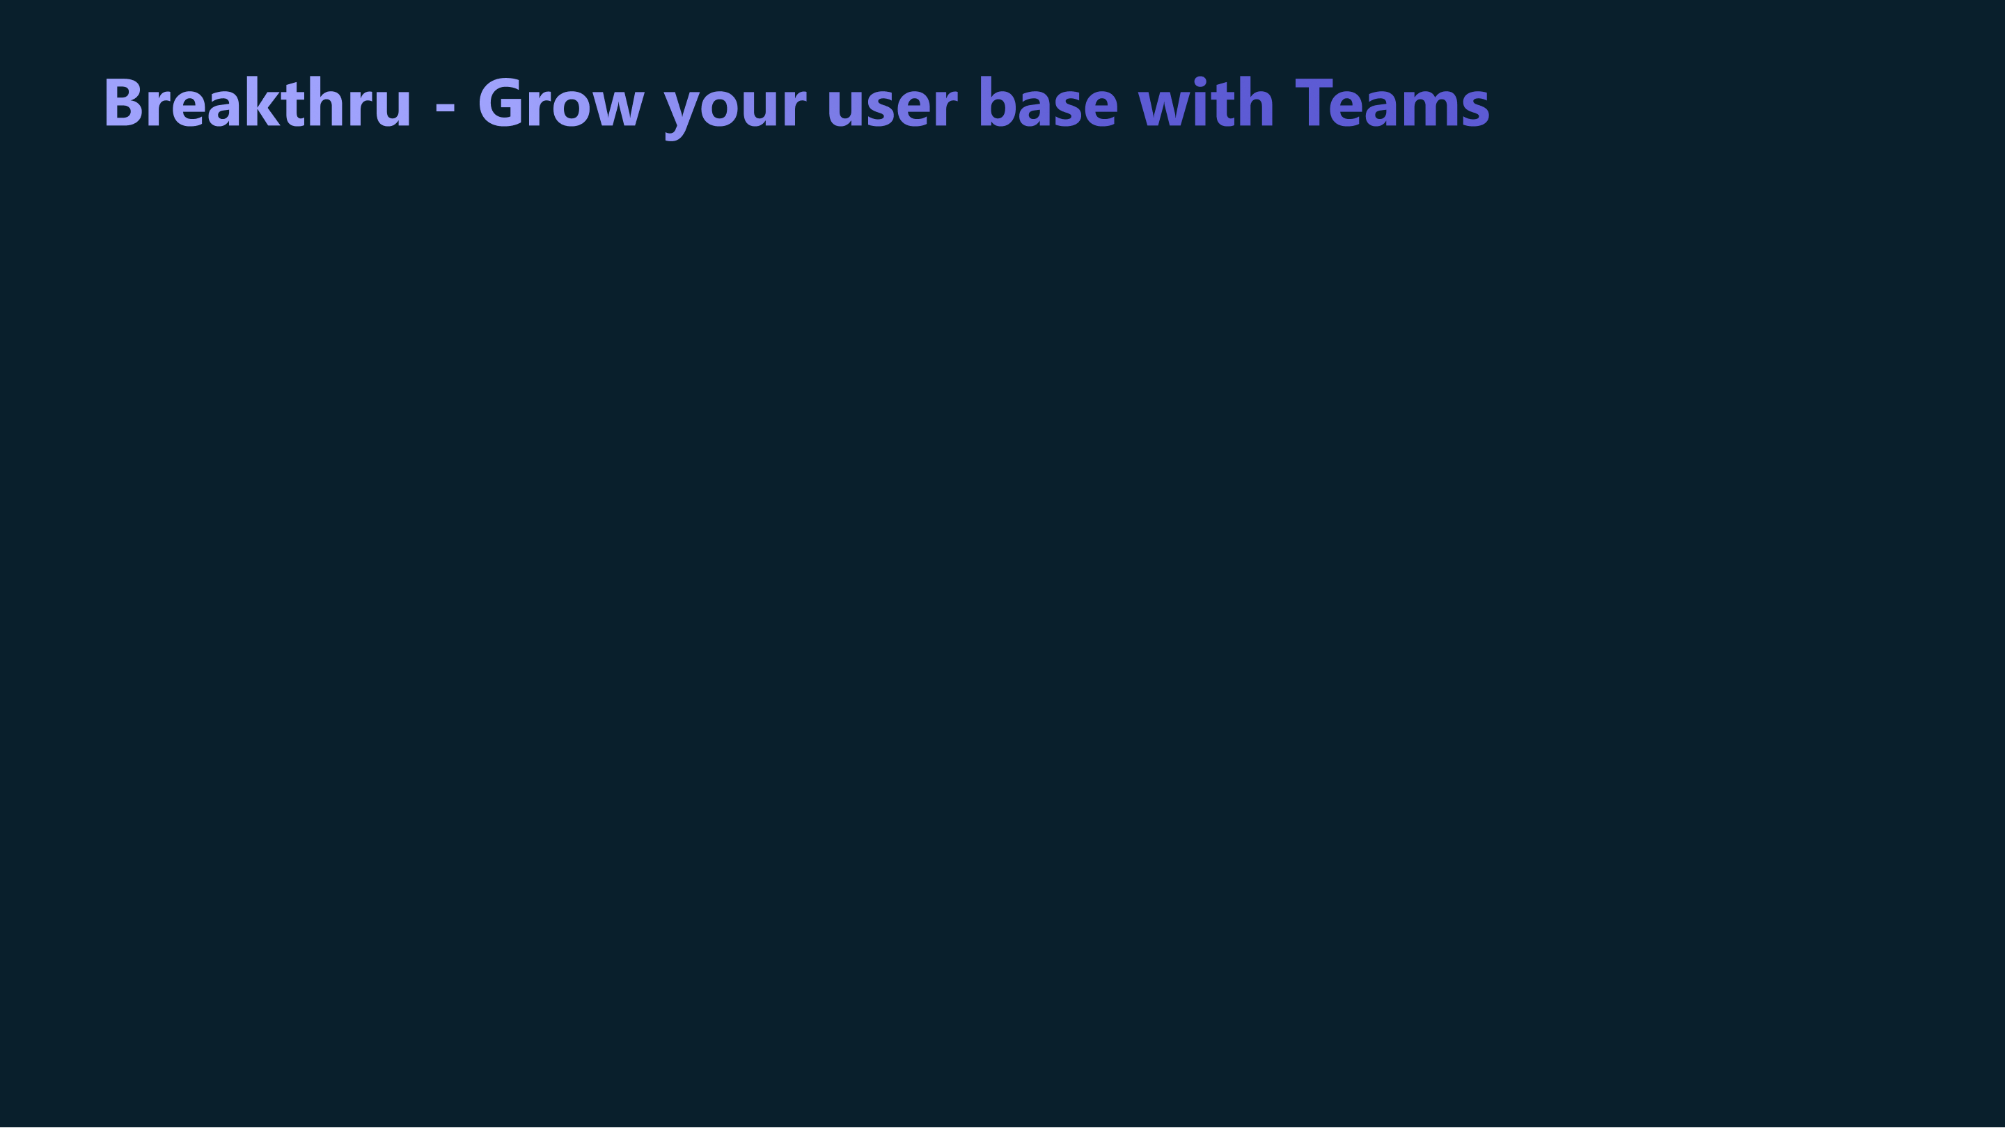
Situation: Breakthru offers a tiny break taking tool and launched its custom built application directly in Microsoft Teams.
Result: Breakthru has been able to grow to 100,000+ Monthly Active Users in 65 countries. Companies like lululemon have adopted the Breakthru app to share wellbeing messages directly in Teams and Outlook enabling Breakthru to scale easily and simplify transactions.
Breakthru + M365
Notes:
Article: https://startups.microsoft.com/blog/breakthru-teams/
Video: https://cloudpartners.transform.microsoft.com/practices/modernworkisv?tab=success-stories

Slide 11

Situation: Mural is a collaborative intelligence company that allows teams to work together no matter where they are. Mural realized that they wanted to partner with Microsoft early on.
Result: Mural has leveraged the Microsoft commercial marketplaces to increase their scale. Being a Microsoft ISV partner has brought Mural a growing number of Microsoft influenced opportunities and has enabled Mural to deliver customer value and seamless integration within a single platform, at scale.
Mural + M365
Notes:
Overview: https://mural.co/partners/microsoft/teams
Video: https://cloudpartners.transform.microsoft.com/practices/modernworkisv?tab=teams-app-opportunity

Slide 12

Learn how to reuse your existing application or build a quality Teams application integrated with your solution https://aka.ms/app-camp
Learn how to include a SaaS offering with your Teams application and publish it on the Microsoft Commercial Marketplaces https://aka.ms/app-camp-monetization
Apply to Microsoft’s ISV Success Program when you are ready to build your Teams application to take advantage of any eligible build and marketing benefits https://aka.ms/isv-success-program
Notes:
So what’s next?
The first step is to learn to build a quality teams application. Throughout App Camp, you will learn about the technical aspects of how to build or reuse portions of your existing application to run in Teams. You want to take advantage of the extensible features of Teams to make your solution the best to meet your customers unique needs.
Then, watch the videos and do the monetization lab in App Camp to learn about Microsoft’s Commercial Marketplace.
And finally, when you are ready to build your app, apply to the M365 ISV Benefits Success program. There you can take advantage of any build incentives and marketing benefits that you may be eligible for. Read the requirements and be aware of any applicable time limits.

Slide 13

Founders Hub brings people, knowledge and benefits together to help startups at every stage solve startup challenges.
Sign up in minutes with no funding required. https://aka.ms/founders-hub
#TeamsAppCamp
Notes:
(IF APPLICABLE) Finally, For the startups out there, we suggest starting at MS’s Founders Hub. At FH, we bring technology and expertise together to help founders and startups solve business challenges. Signup is streamlined and takes just a few clicks.

Slide 14

#TeamsAppCamp

